Slide 1
UNIT 3: PUZZLES AND GAMES

Slide 3
1/ This is a type of vetebrates. There are four letters.
_________________ | _________________ | _________________ | _________________
F
I
S
H

Slide 4
1/ This is a type of vetebrates. There are seven letters.
____________ | ____________ | ____________ | ____________ | ____________ | ____________ | ____________
M
A
M
M
A
L
S

Slide 5
1/ This is a type of vetebrates. There are eight letters.
___________ | ___________ | ___________ | ___________ | ___________ | ___________ | ___________ | ___________
R
E
P
T
I
L
E
S

Slide 6
1/ This is a type of vetebrates. There ten eight letters.
________ | ________ | ________ | ________ | ________ | ________ | ________ | ________ | ________ | ________
A
M
P
H
I
B
I
A
N
S

Slide 7
1/ This is a type of vetebrates. There are four letters.
_________________ | _________________ | _________________ | _________________
B
I
R
D

Slide 8
GUESSING GAME
Work in groups. Think of an animal. Ask and answer the questions in exercise 4 and your own questions. Guess the animals.

Slide 9
What things are beautiful?
Time’s up
2 mins

Slide 10
What things are common?
Time’s up
2 mins

Slide 11
What things are dull?
Time’s up
2 mins

Slide 12
What things are colorful?
Time’s up
2 mins

Slide 13
What things are rare?
Time’s up
2 mins

Slide 14
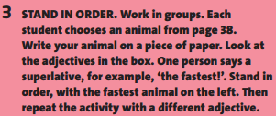
big,
fast,
dangerous,
heavy,
intelligent,
rare,
pretty,
ugly

Slide 15
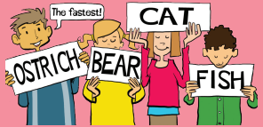
* For example:
cat, bear, fish, ostrich

Slide 16
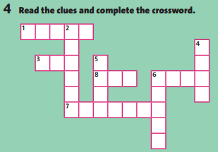
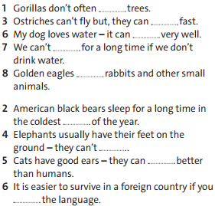
C
L
I
M
B
O
J
R
U
N
H
U
T
E
A
T
S
W
I
M
H
A
P
P
S
U
R
V
I
V
E
A
K

Slide 17
1/ I’ve got eight legs.
2/ I’m quite big.
3/ I can swim.
-> You are an octopus.

Slide 18
1/ I’m a large bird from Africa.
2/ I can run fast.
3/ I can’t fly.
-> You are an ostrich.

Slide 19
1/ I’m a very dangerous animal.
2/ I’ve got a very big mouth.
3/ I am long and green.
-> You are a crocodile.

Slide 20
How far ...?
How tall ...?
How fast ...?
How many ...?

Slide 21
* Homework: - Review the grammar structures and new words of unit 3. - Prepare Unit 4: “Learning world-Vocabulary: School subjects”.

